Slide 1

Stress Corrosion Crack (SCC) Identification using Deep Learning
AI specialist:
Camila Jobim
Juliana Cerqueira
Leonardo Barbosa
Oskar Sjostedt

Slide 2
AGENDA
BUSINESS PROBLEM
AI SOLUTION
ROI & BUSINESS VALUE
DATA
DEVELOPMENT
DEPLOY
NEXT STEPS

Slide 3
BUSINESS PROBLEM
During service, corrosive gases present in the production fluids, can penetrate to reach the metallic wires building aggressive environments. All this, associated with the residual stresses of the flexible pipeline manufacturing and service process, triggers one of the most dangerous forms of corrosion Stress Corrosion Cracking (SCC) in which may harm the efficiency, causing the fracture of flexible pipe.
In order to access the level of damage to the wires, several dissection from field samples have done has resulted in a substantial number of macrographs depicting cracks and defects (as result of the corrosive environment) in the armor and pressure wires. However, currently, these images are processed manually, which is a time-consuming process taking many hours and is subject to errors. It is important to point out that all these information of crack area and length are used for the flexible pipe lifetime projection.

Slide 4
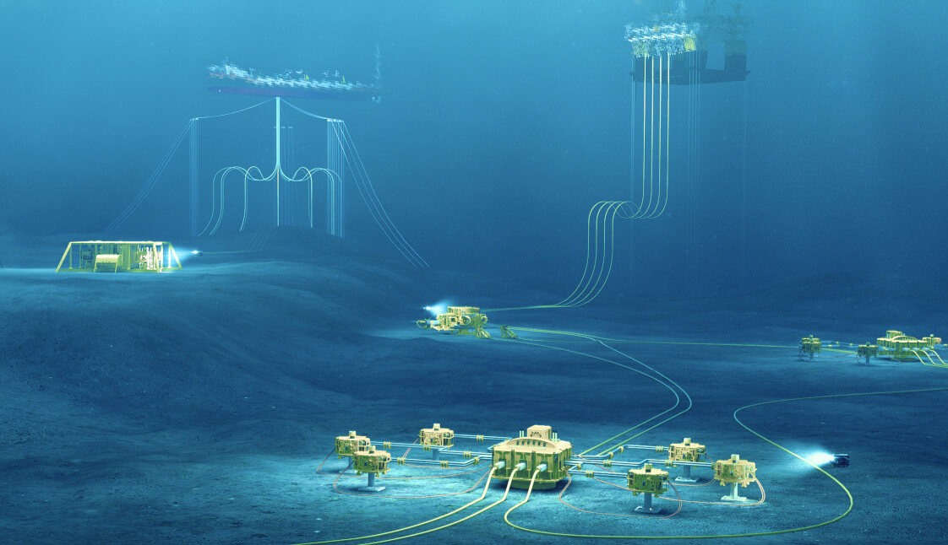
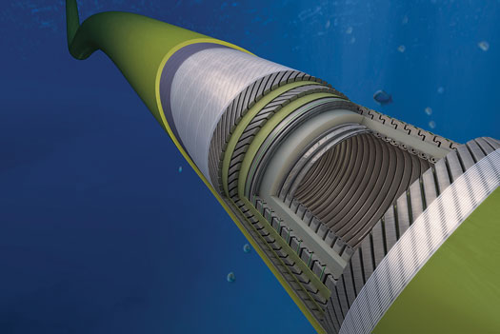
BUSINESS PROBLEM
Corrosive
Enviroment
Tensile
Stress
Metallurgy
SCC

Slide 5
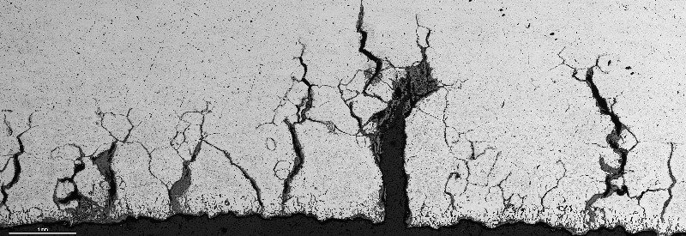
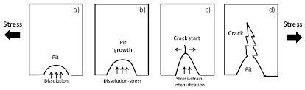
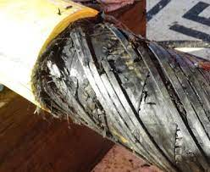
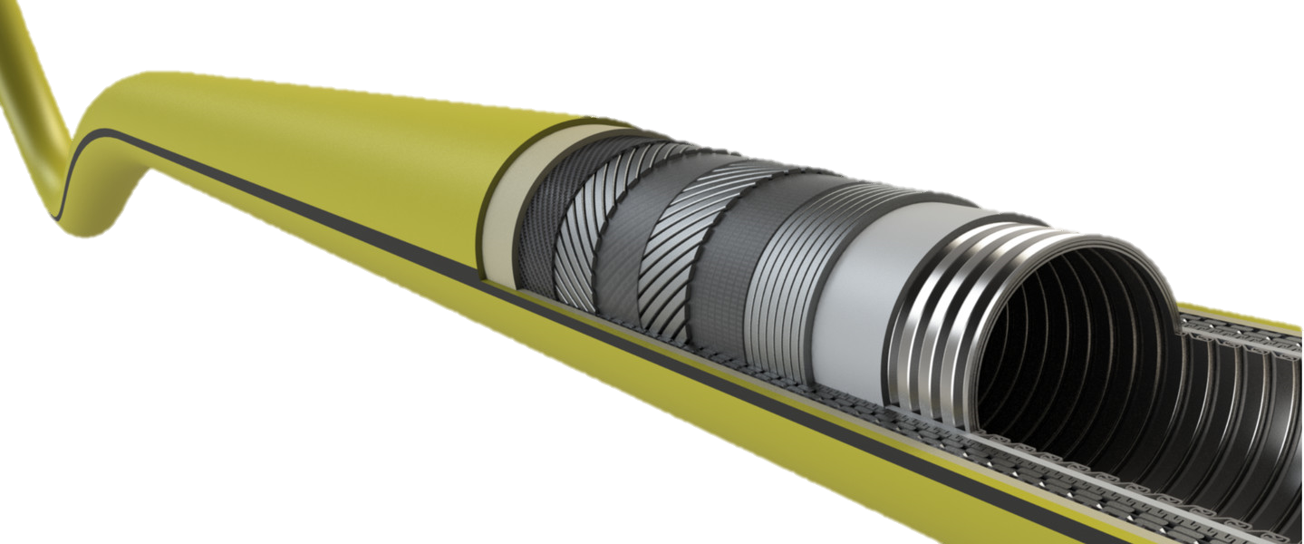
BUSINESS PROBLEM

Slide 6
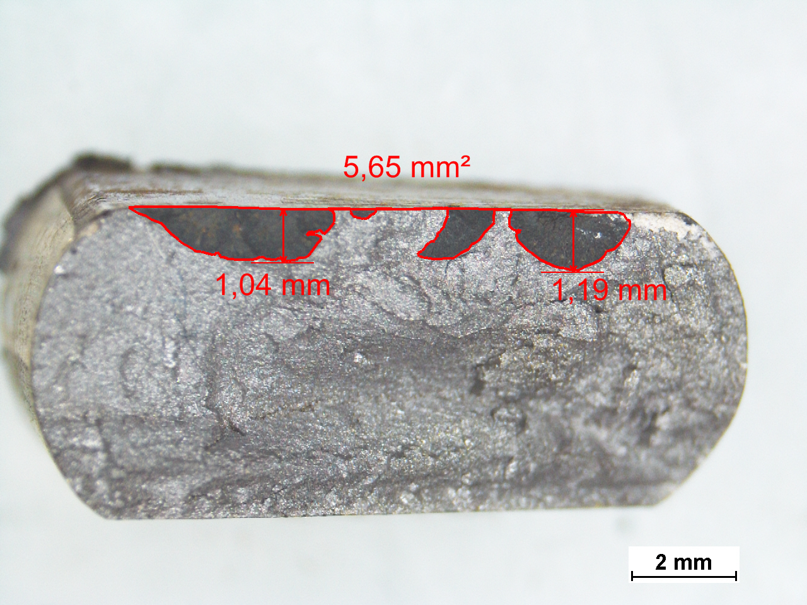
BUSINESS PROBLEM
Manually Process
Up to now:
Over 4000 wires analyzed
Over 1000 macrographs performed
About 5 min/macrograph
Total: approximately 83 hours

Slide 7
AI SOLUTION
Developing a convolutional neural network (CNN) which is a type of Deep Neural Network that is commonly used in computer vision tasks such as image classification, object detection and segmentation.
To achieve this, the UNet architecture was implemented using Keras to have image segmentation based on several imagens from past projects to train the model from different images of two different metallic wires shapes (and pressure wires).
After doing this, the model will be able to perform semantic segmentation on input images to label each pixel to detect the cracks and extract its measures (crack area and its length).

Slide 8
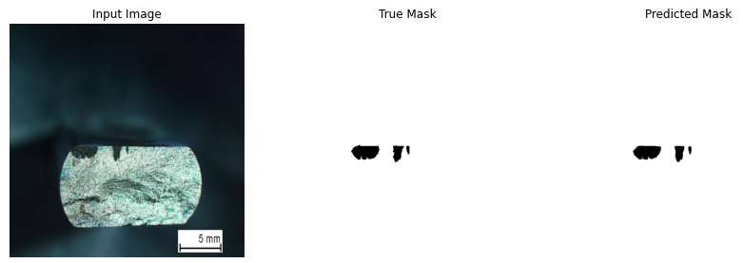
Deep Neural Network (Convolutional Neural Network – CNN)
UNet architerature using Keras to train the model
With Deep learning identification
About 10s/macrography
About 3h total (1000 macrographs)

Slide 9
ROI & BUSINESS VALUE

Slide 10
Deep Neural Network (Convolutional Neural Network – CNN)
ROI Impact & Estimative
80.5h could be saved over 1k macrographs taken since 2017;
LCTMAT takes around 5 min to have the crack localization and its area and length, totalizing 83.3h (1k macrographs).
ROI = 96,7%
Furthermore, there are several positive qualitative impacts not measured by the ROI such as standardization, reliability and possibility to increase the database providing more data for the projects.
Business Value
Automating the SCC identification using deep learning can provide several benefits, including:
Saving time of technicians and engineers. This frees up engineers to focus on more complex tasks that require their unique experience and skills;
Possibility to generate even more data with no backlog limit for technicians/engineers (needing only a human oversight, as per recent AI Center of Excellence guideline).
Path to industrialization by removing the subjective criteria, leading to standardization;
Data-driven decision making.

Slide 11
DATA

Slide 12
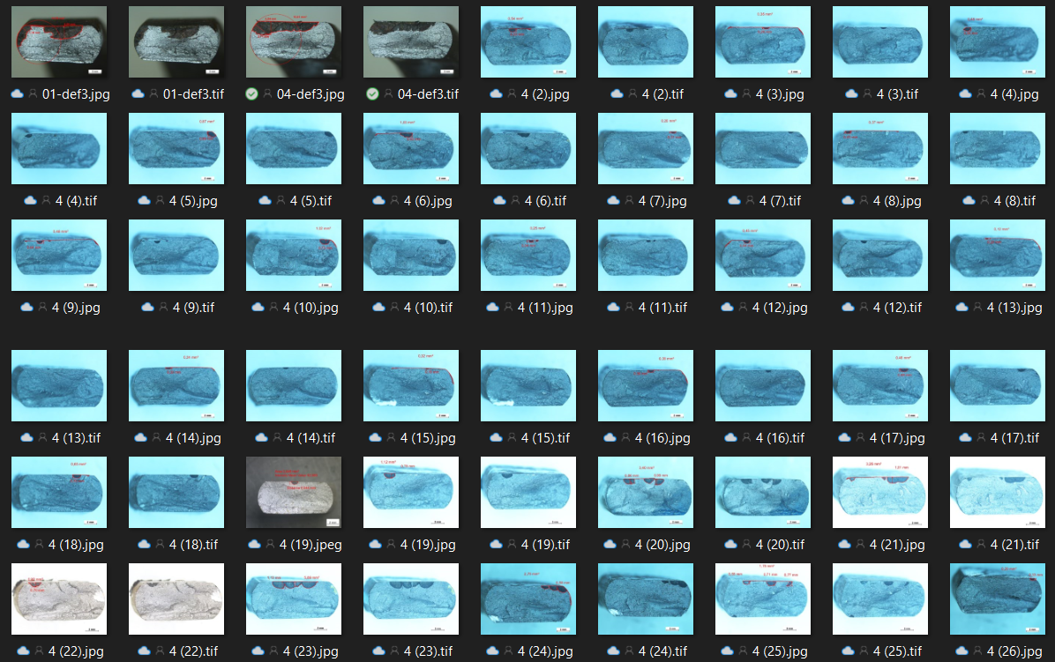
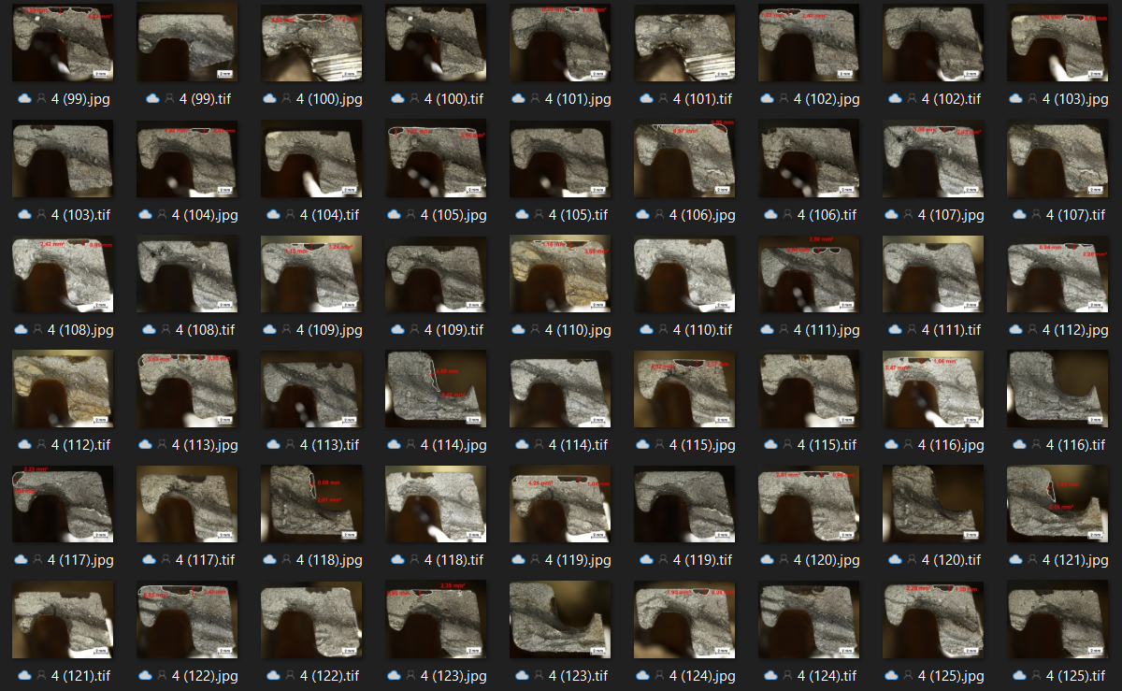
DATA
+1200 IMAGES

Slide 13
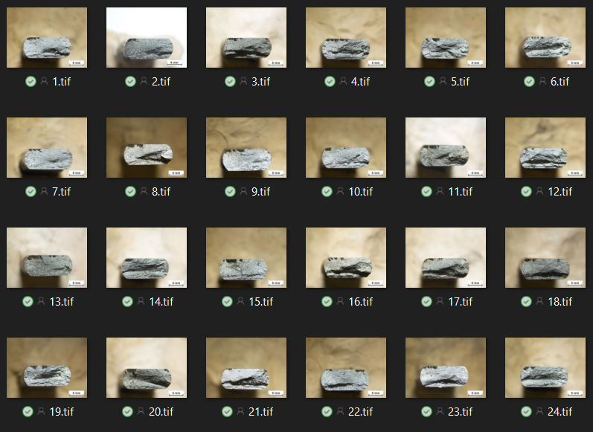
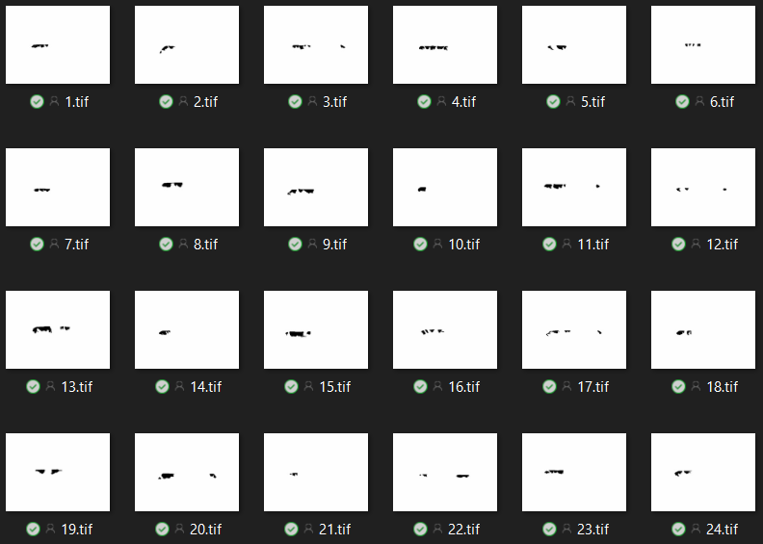
DATA
TRAIN MASK

Slide 14
DEVELOPMENT

Slide 15
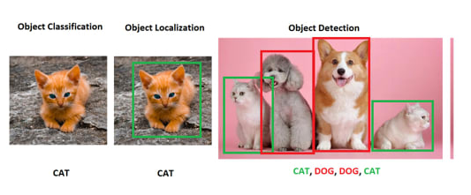
DEVELOPMENT
1 - Difference between Classification, Localization and Detection

Slide 16
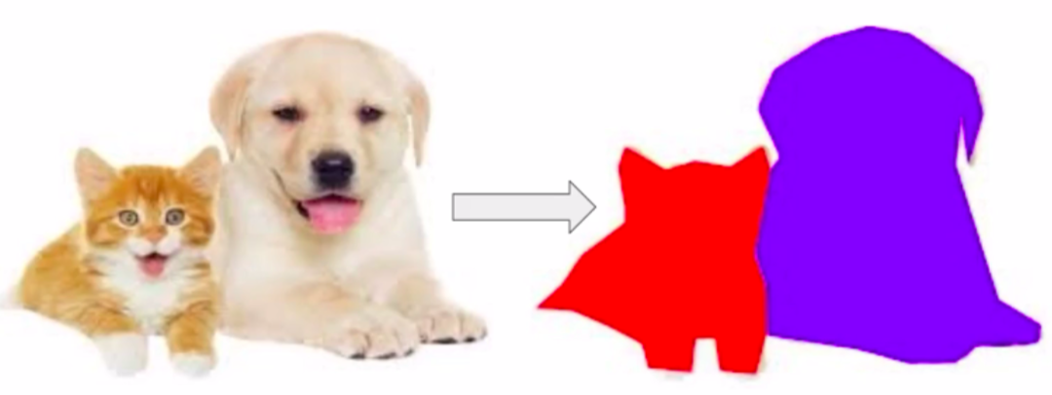


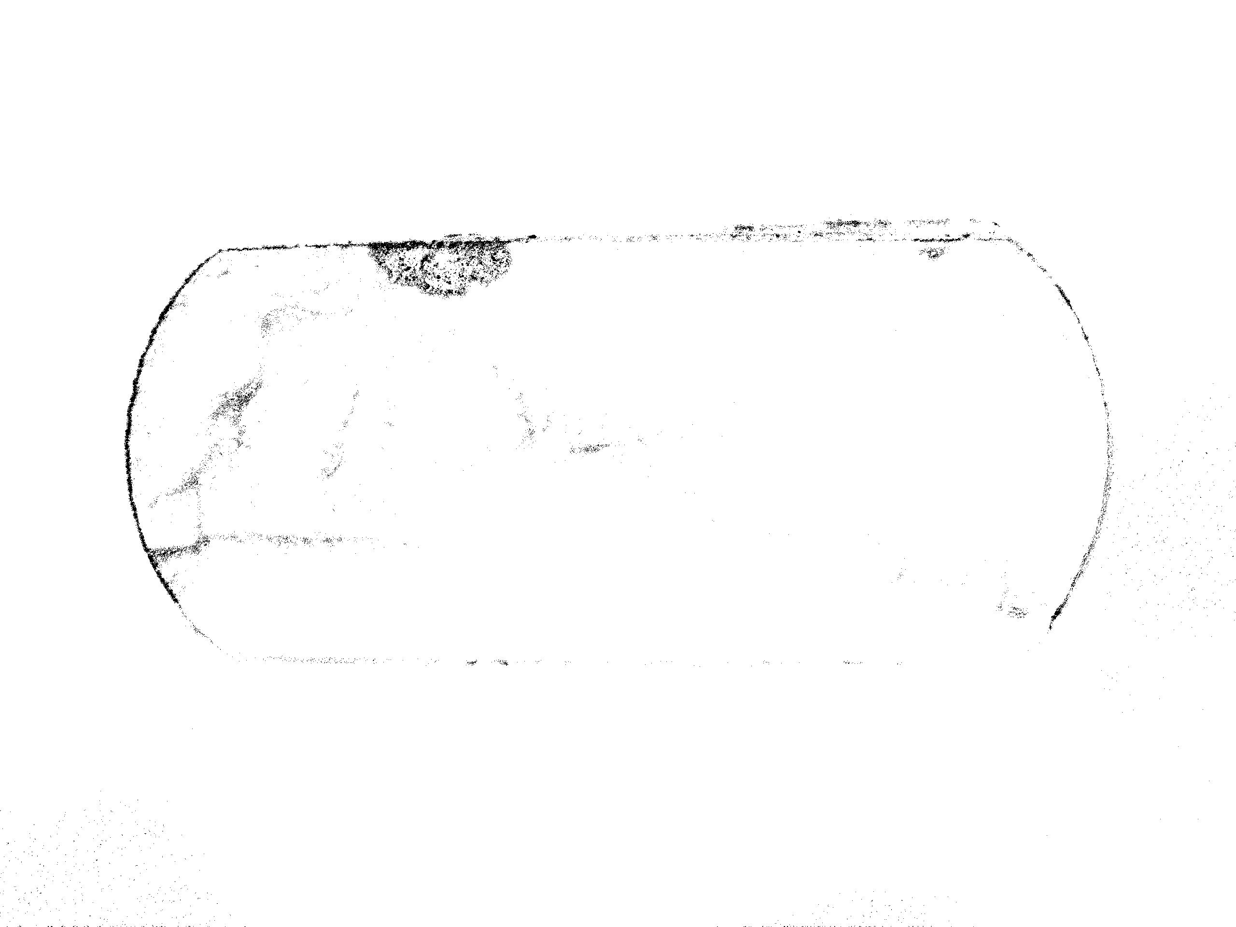
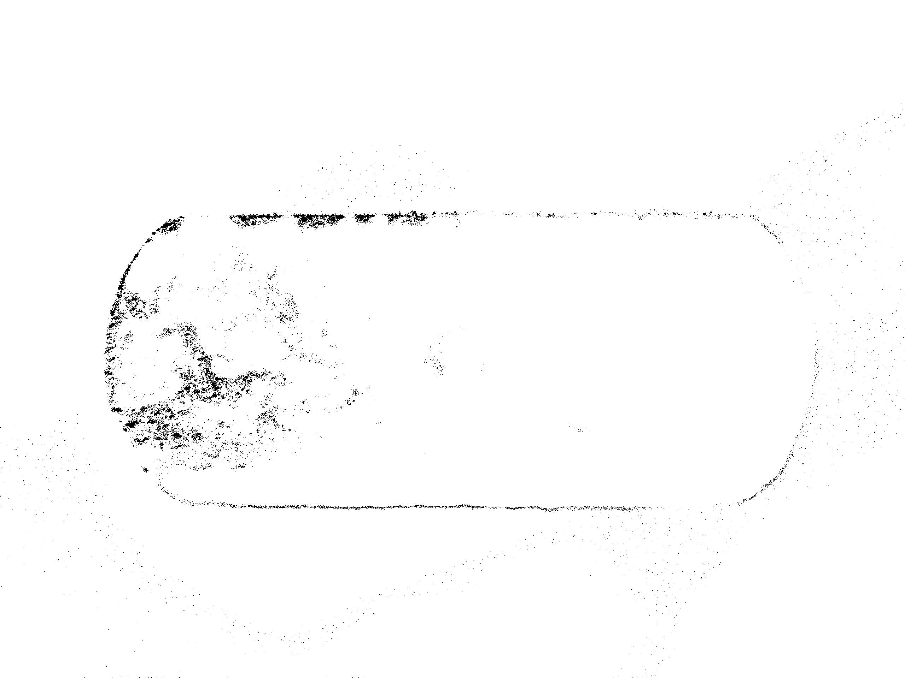
DEVELOPMENT
2 – Semantic segmentation (categorize each pixel as “crack” or “not crack”)
Random Forest (Decision Trees)
Issue: overfitting, memory usage
Train dataset
Test dataset

Slide 17
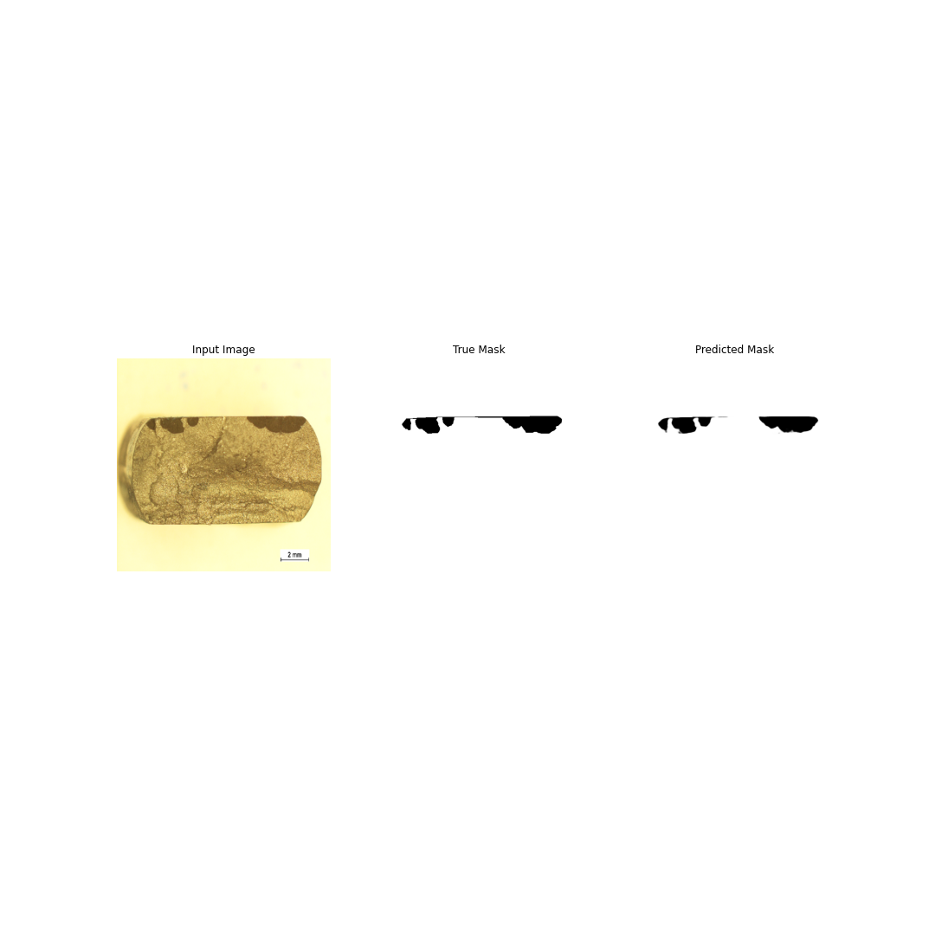
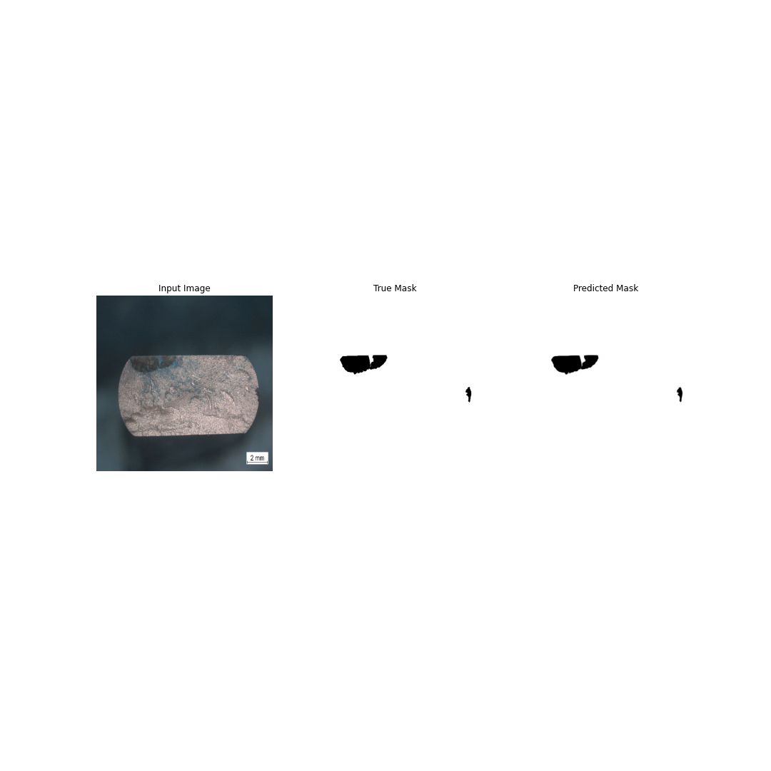
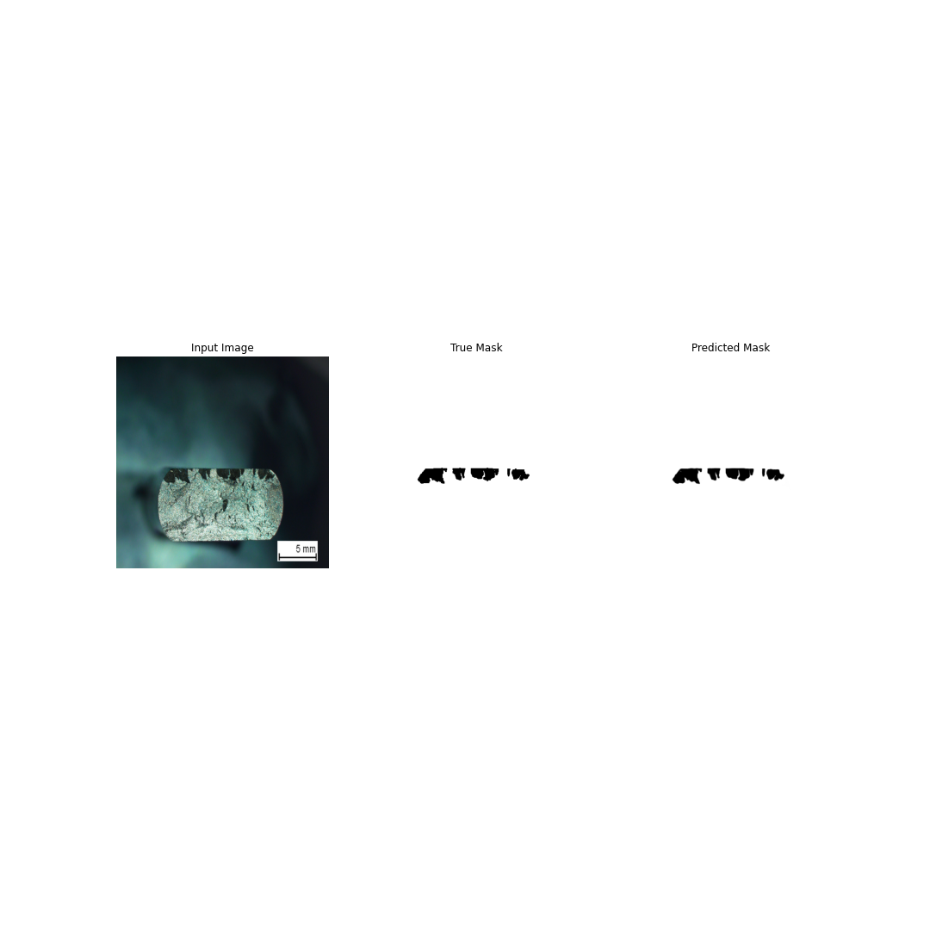
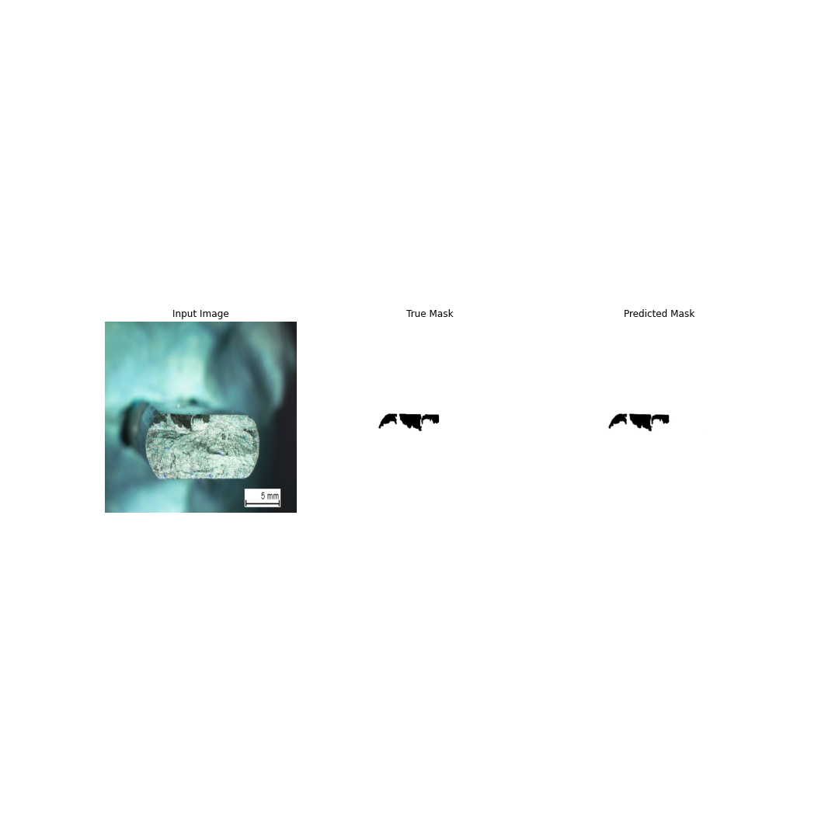
DEVELOPMENT
3 – Convolutional Neural Networks (CNN)
UNet

Slide 18
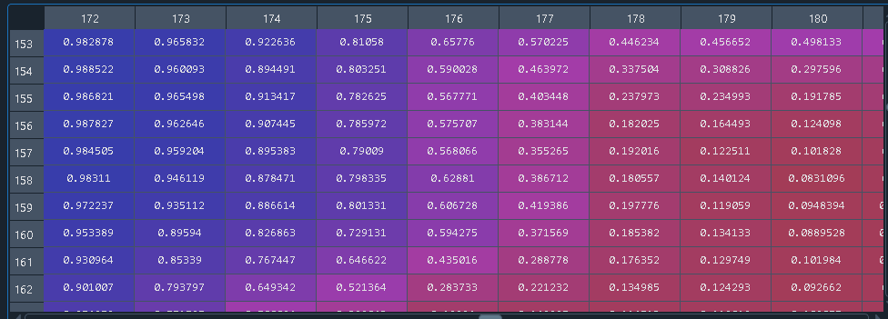
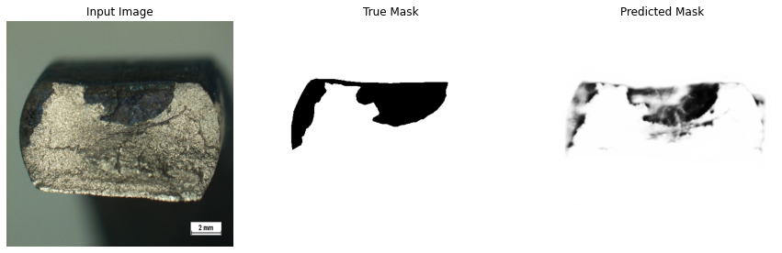
DEVELOPMENT
3 – Convolutional Neural Networks (CNN)
UNet
Sigmoid activation on output layer
Output is actually not binary, but a probability
Image below represents a prediction on a model a few epochs in

Slide 19
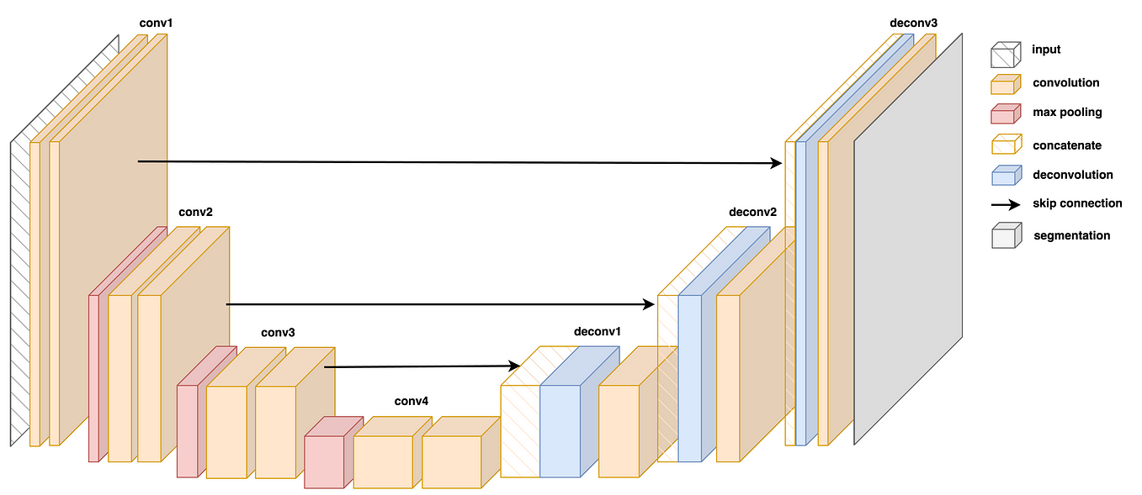
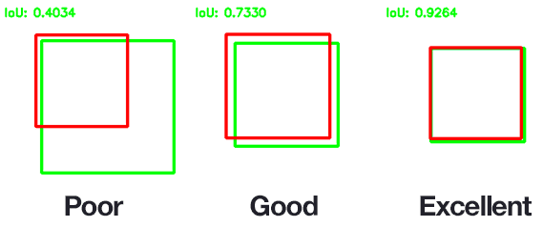
DEVELOPMENT
Metrics:
Binary IoU, Binary Crossentropy
U-net architecture

Slide 20
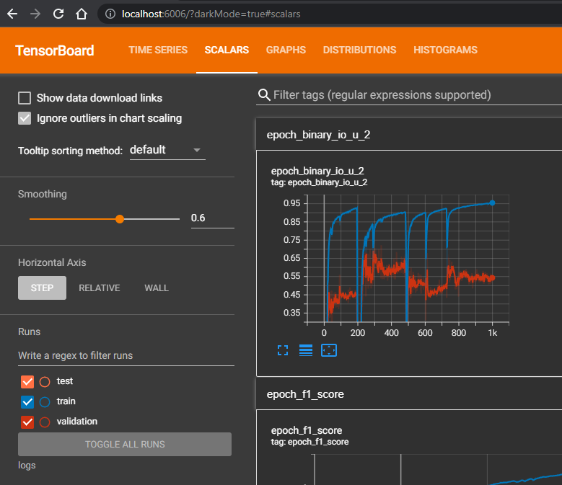
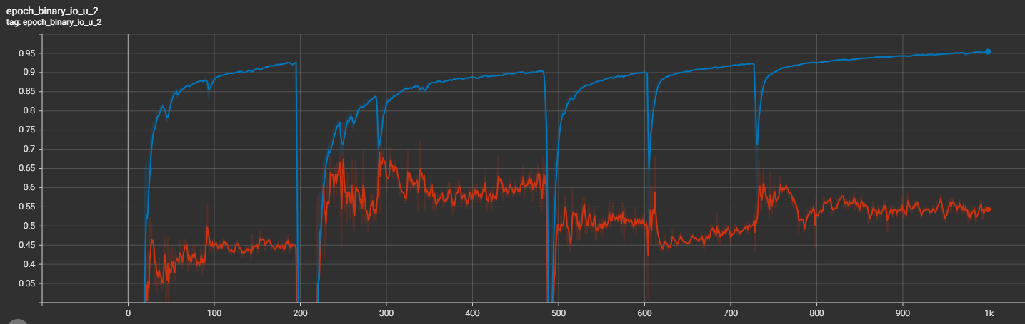
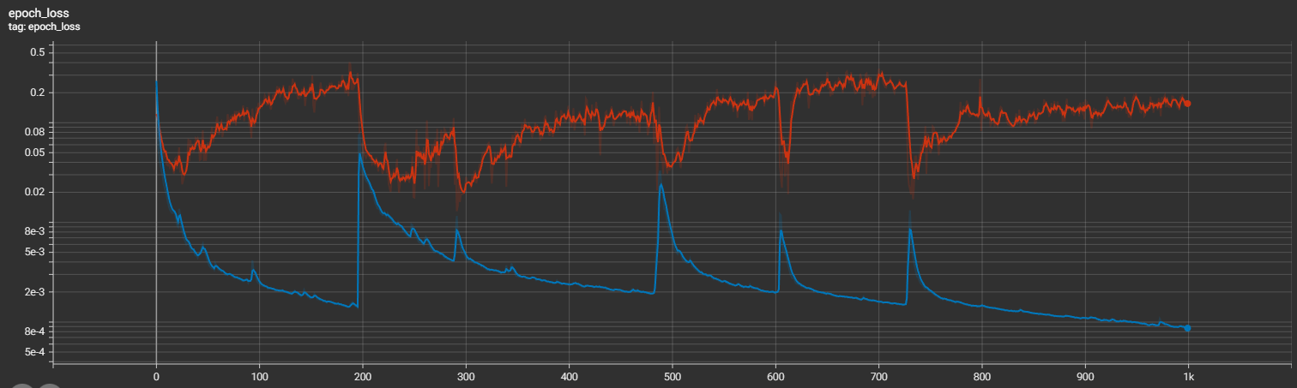
DEVELOPMENT
Training metrics monitored via Tensorboard
Binary IoU (Jaccard)
Loss: Binary Crossentropy

Slide 21
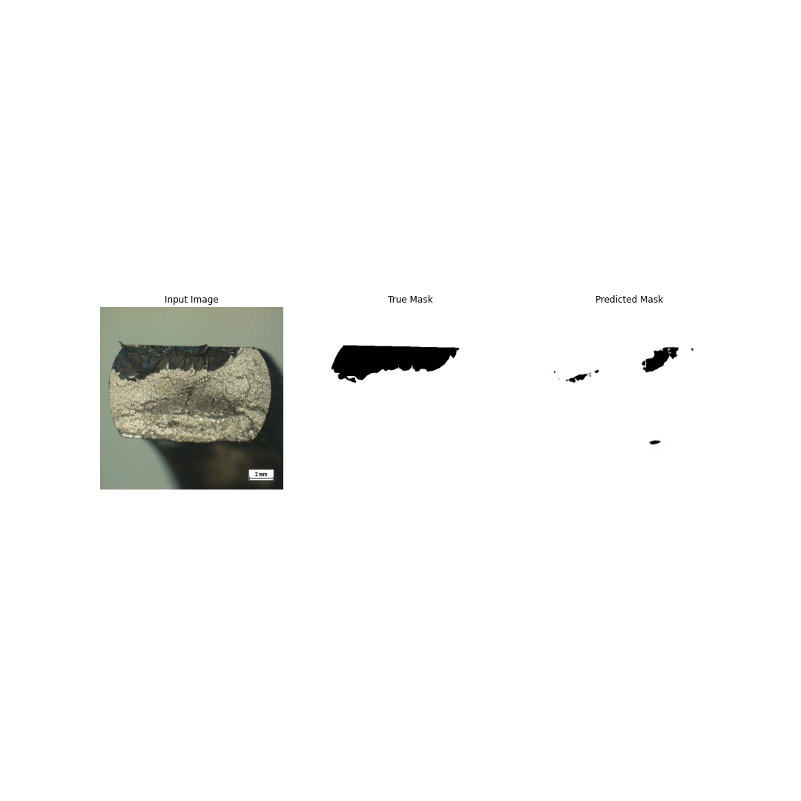
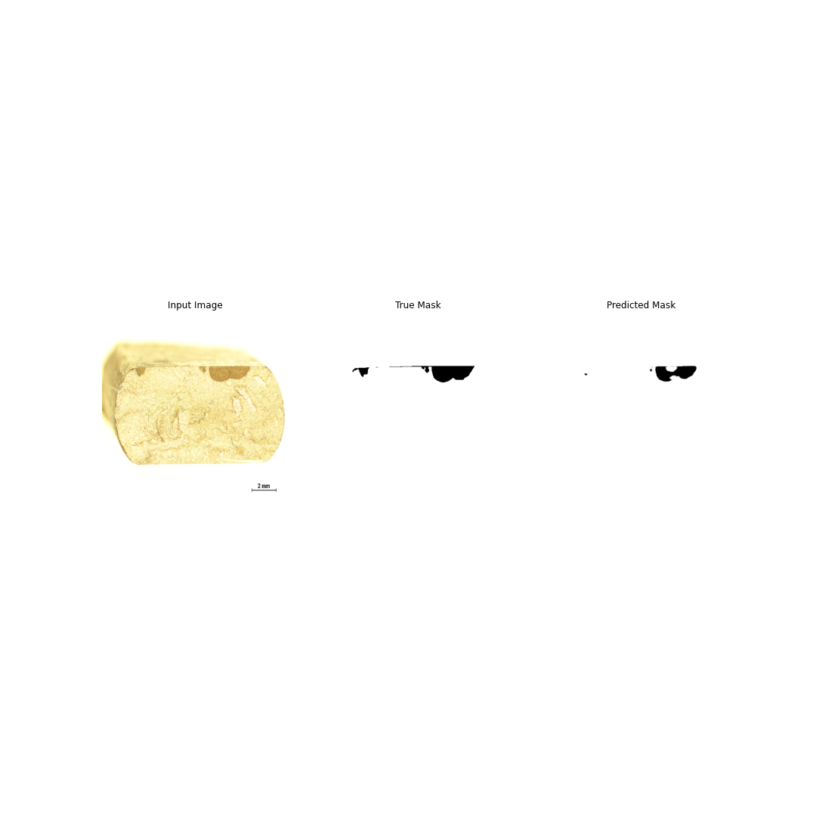
DEVELOPMENT
3 – Convolutional Neural Networks (CNN)
UNet
Underrepresented images are not well predicted
Issue:

Slide 22
DEPLOY

Slide 23
NEXT STEPS
Increase number and variability of imagens to train a new model – Data augmentation
Histogram equalization of images to remove brightness issues
Improve method to inform image scale
Inform length, depth and area of cracks on the app
Generate edges in red as before – Sobel filter
Deploy app on a server
Segment batches of images
General user experience improvements
Different network architecture

